Slide 1

from Office City

Slide 2
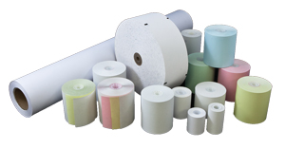
Bond & Thermal Rolls
100% Satisfaction Guaranteed
Bond
Thermal
2-Ply Carbonless (White/Canary) (White/White)
3-Ply Carbonless (White/Canary/Pink)
ATM Rolls (Bond/Thermal/Heavyweight)
Verifone Kits

Slide 3
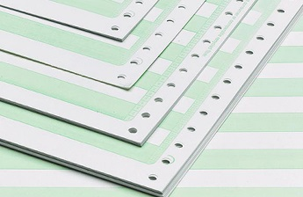
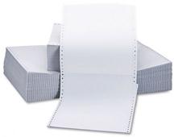
Computer Paper
Grade
Bond
Carbon Interleave
Premium Carbonless
Format
Blank
1/2" Green Bar
1/2" Blue Bar
1/6" Green Bar
1/8" Green Bar
Weight
15#
18#
20#

Slide 4
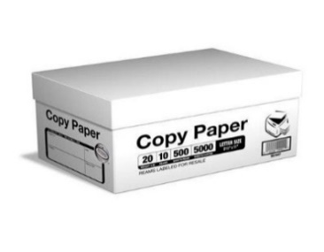
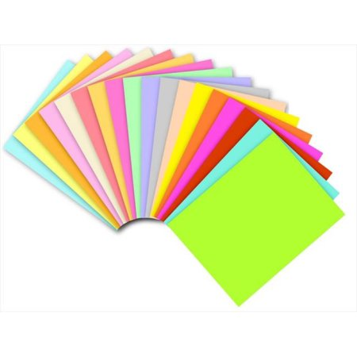
Copy Paper
Bright White
Assorted Colors

Slide 5
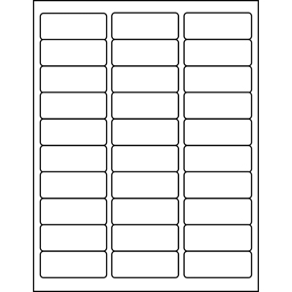
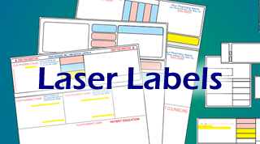
Printer Laser Labels
The Best Sizes

Slide 6
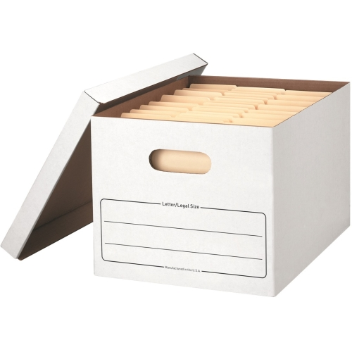
Extra Strength Storage Box
Stackable up to 350 lbs
Storage Box, Letter/ Legal, Lift- off Lid, White, 12/ Carton
Double end, single side construction. Lift-off lid ships attached to prevent lid loss, then tears off for use. Light duty, basic setup construction for moderate stacking or use with shelving. Includes twelve storage boxes and twelve lids.
12" x 15" x 10" - Letter/Legal Size

Slide 7
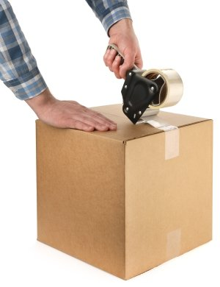
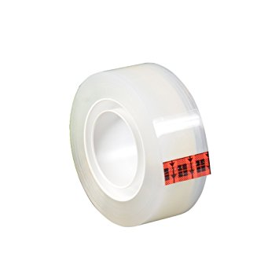
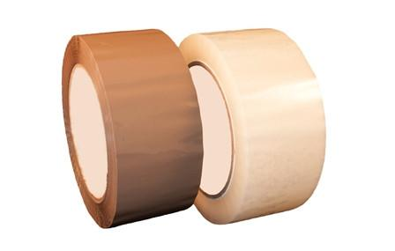
Box Sealing Tape
Acrylic Adhesive Based

Slide 8
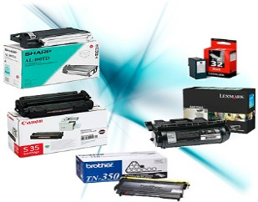
Compatible Laser Toners
A+ Quality
We have hundreds of compatible toners, ink jet cartridges & thermal rolls available. We carry the Brother, Hewlett Packard, Canon, Dell. Send us your items and we will quote you.

Slide 9

Office City of Miami, Inc.
9349 Dominican Drive
Miami, Florida 33189
(786)-473-1828
officecity@gmail.com

