Slide 1


Slide 2




Office City of Miami
9349 Dominican Drive
Miami, Florida 33189
Phone (786)-473-1828
officecity@gmail.com

Slide 3


Pencils & Markers
2025

Slide 4
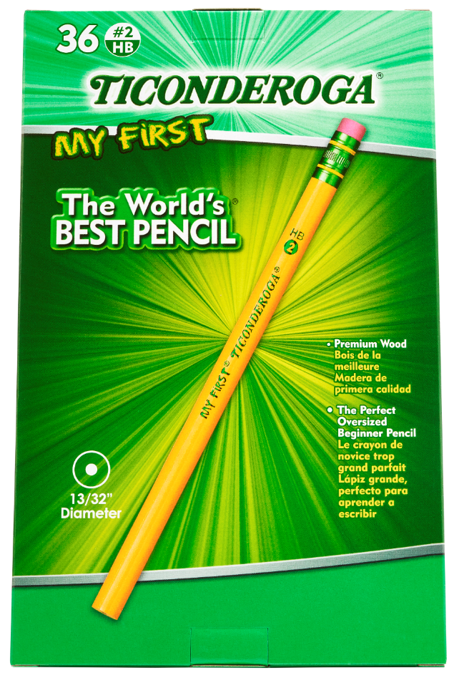
36ct Ticonderoga® My First Pencils with Eraser
Large size diameter (13/32") is ideal for children in the early stages of their writing development
Exclusive #2 graphite formula provides extra smooth performance
Top quality, latex-free eraser provides easy, clean corrections
Made with premium wood from responsibly managed forests
PMA certified non-toxic
36 pencils per box
Product SKU # | Office City of Miami
X33336X | officecity@gmail.com

Slide 5
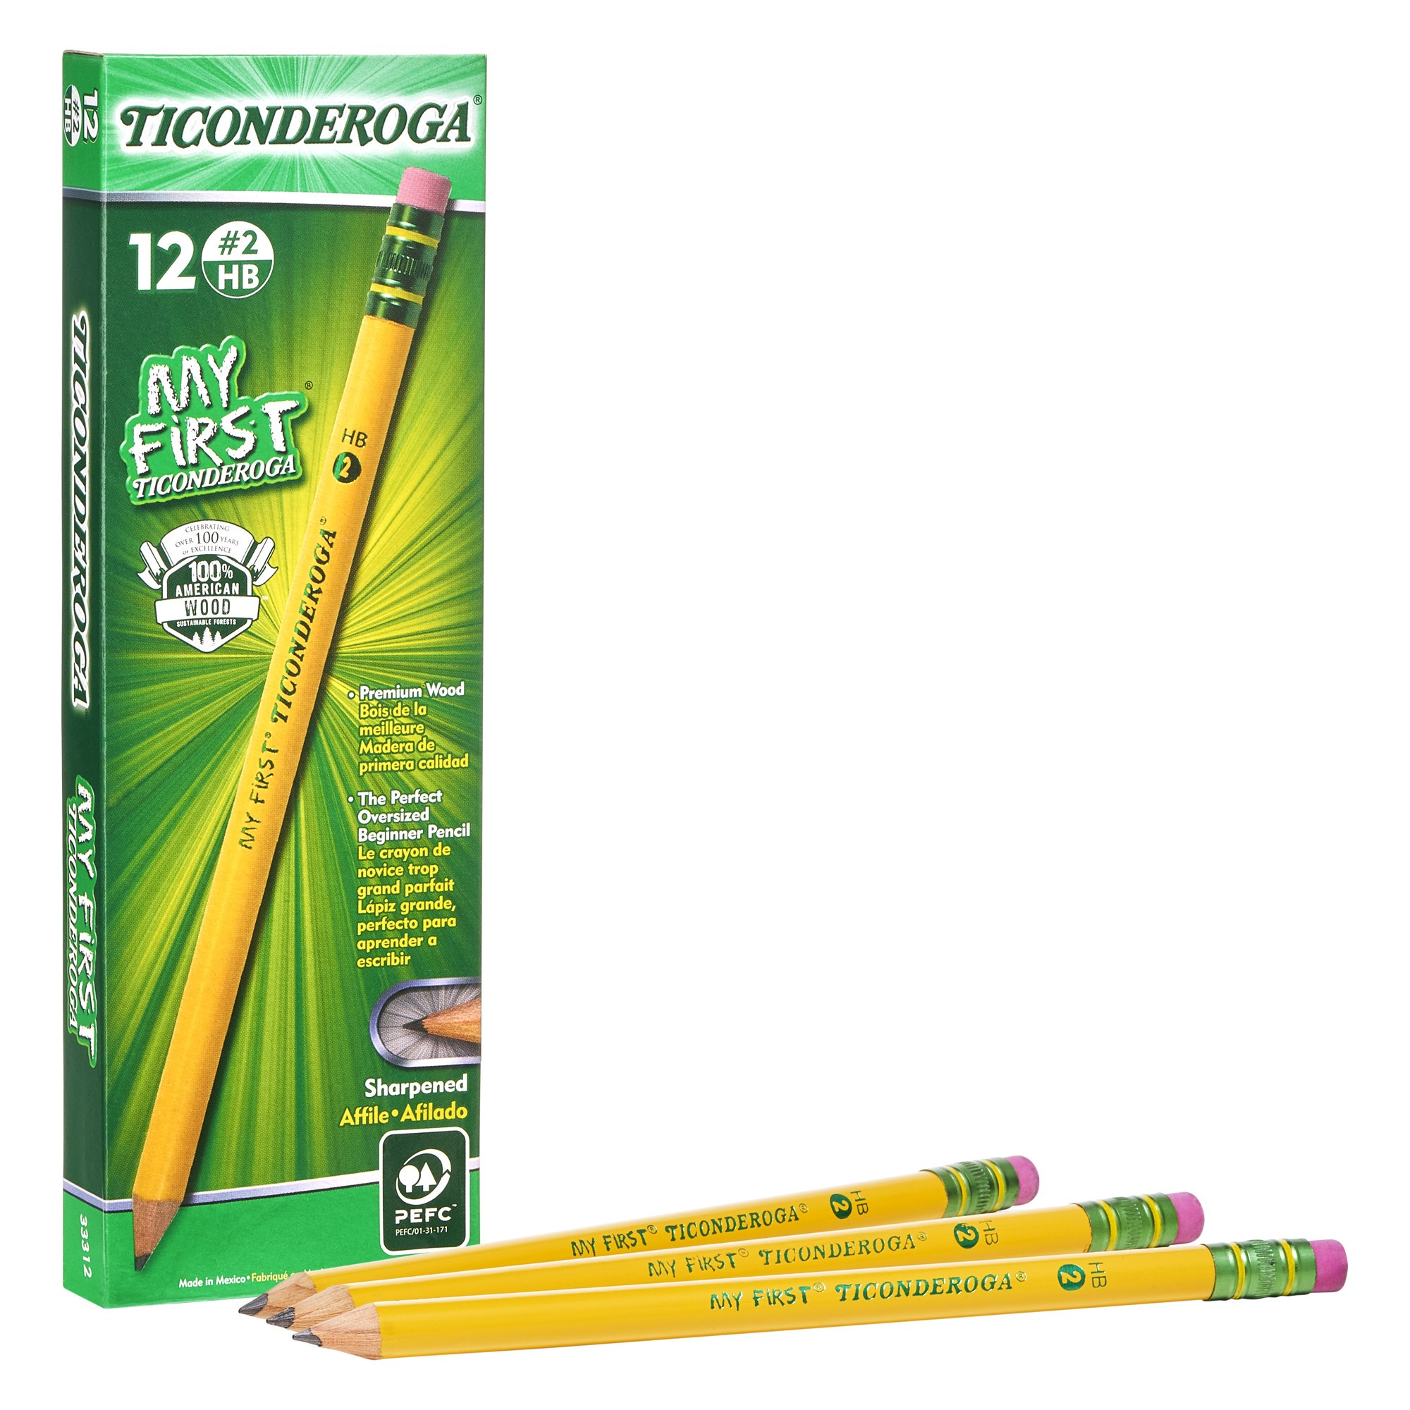
Ticonderoga® My First Pencil, 12 Count
Top selling new product
Larger diameter for children in the early stages of their writing development
Exclusive graphite formula provides extra smooth performance
Pre-sharpened to save you time
Larger top quality, latex-free eraser provides easy, clean, smudge free corrections
PMA certified non-toxic
Made with premium wood from responsibly managed forests
12 pencils per box
Product SKU # | Office City of Miami
X33312X | (786)-473-1828

Slide 6
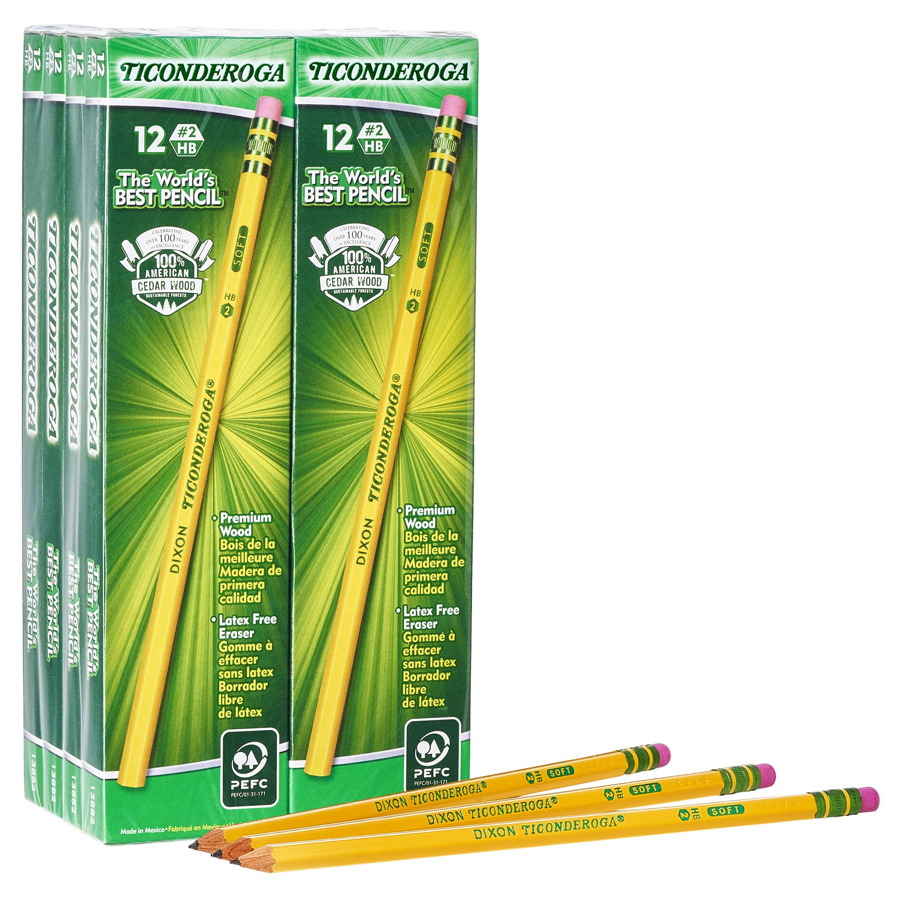
Ticonderoga® 96 Count
#2 Wood Case Pencil
Our #1 Best Seller
Exclusive #2 graphite formula provides extra smooth performance
Pre-sharpened to save you time
Top quality, latex-free eraser provides easy, clean corrections
PMA certified non-toxic
Made with premium wood from responsibly managed forests
Product SKU # | Office City of Miami
X13872X | (786)-473-1828

Slide 7
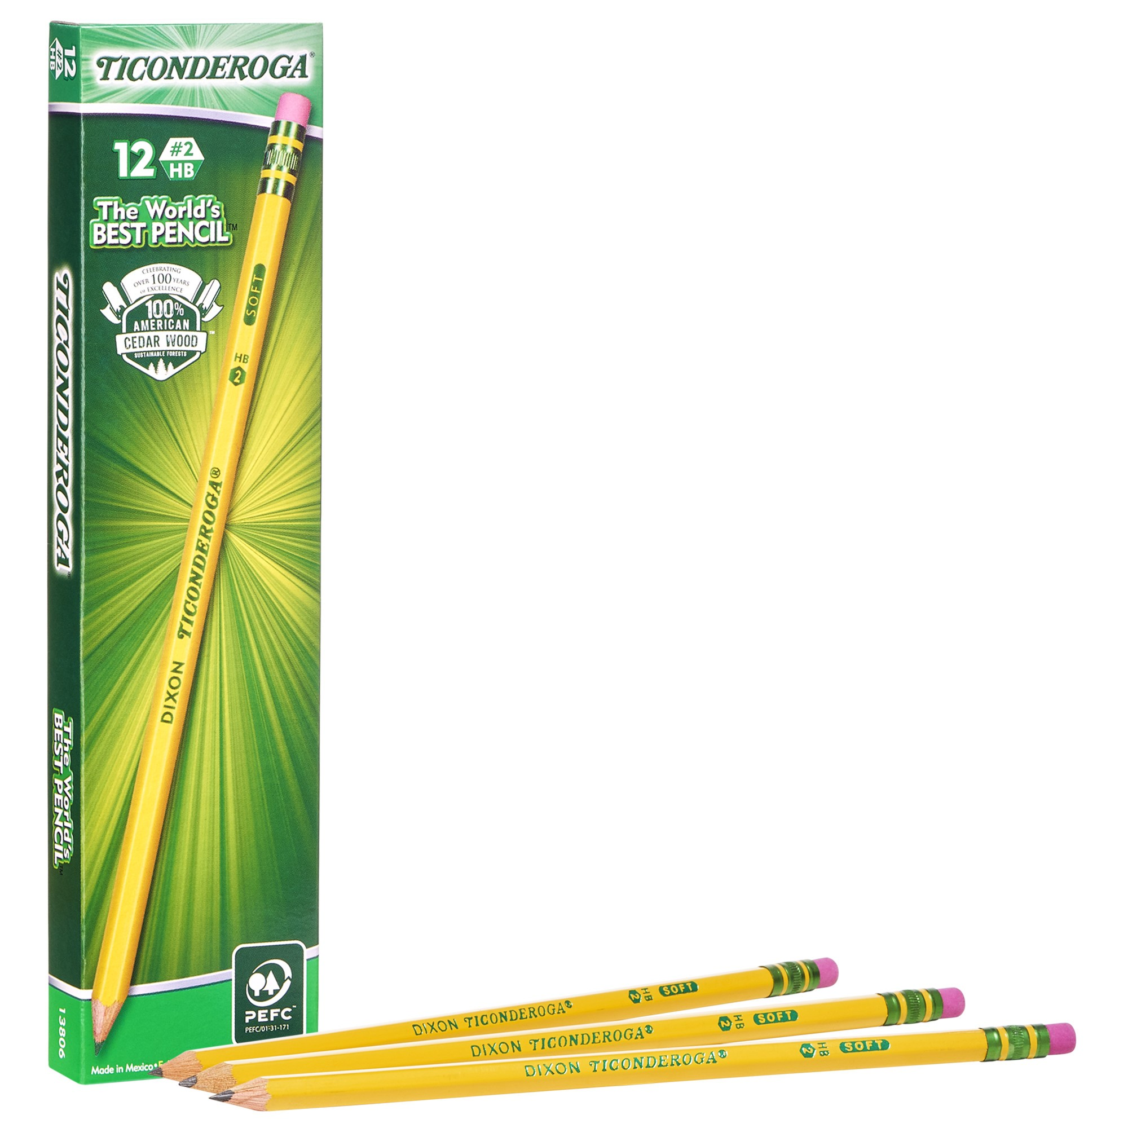
Ticonderoga® 12 Count
#2 Wood Case Pencil
Our number 2 top selling pencil product
Exclusive #2 graphite formula provides extra smooth performance
Pre-sharpened to save you time
Top quality, latex-free eraser provides easy, clean corrections
Made from premium wood from responsibly maintained forests
PMA Certified non-toxic
Product SKU # | Office City of Miami
X13806X | (786)-473-1828

Slide 8
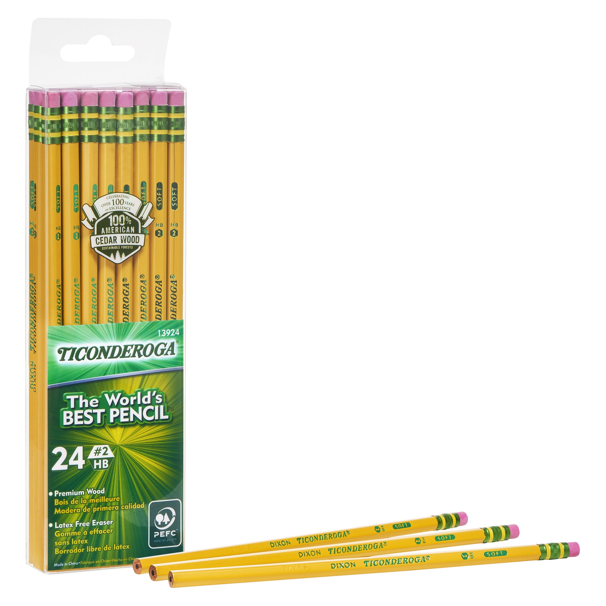
Ticonderoga® 24 Count
#2 Wood Case Pencil
Our number 3 top selling pencil product
Exclusive #2 graphite formula provides extra smooth performance
Top quality, latex-free eraser provides easy, clean corrections
PMA certified non-toxic
Made with premium wood from responsibly managed forests
Product SKU # | Office City of Miami
X13924X | (786)-473-1828

Slide 9
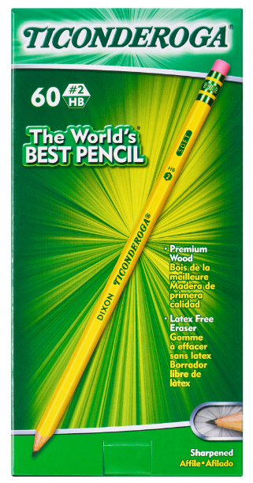
Ticonderoga® 60 Count
#2 Wood Case Pencil
Exclusive #2 graphite formula provides extra smooth performance
Pre-sharpened to save you time
Top quality, latex-free eraser provides easy, clean corrections
PMA certified non-toxic
Made with premium wood from responsibly managed forests
Product SKU # | Office City of Miami
X13060X | (786)-473-1828

Slide 10
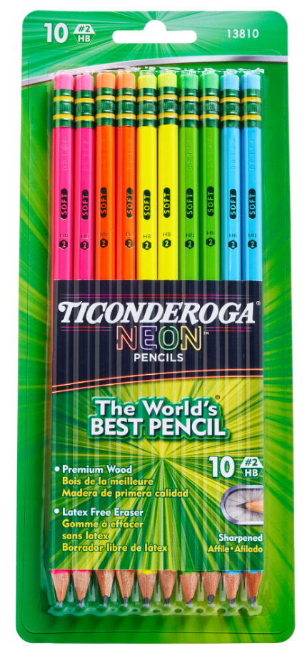
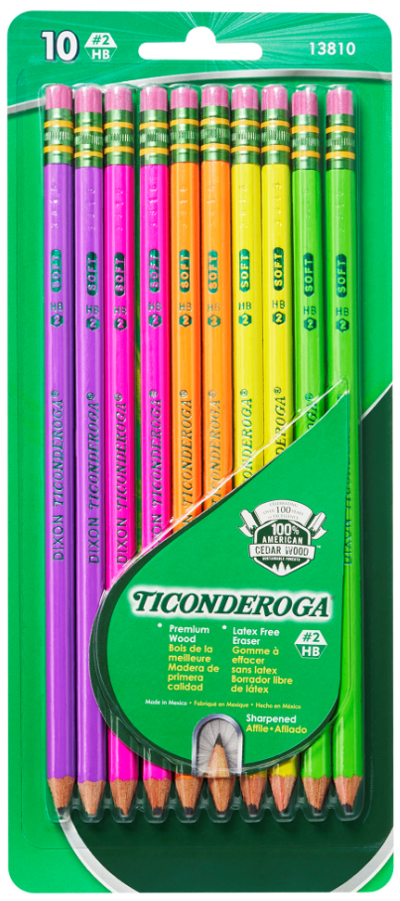
Ticonderoga® 10 Count Neon
#2 Wood Case Pencil
Refreshed with NEW colors!
Five bright, neon colors
2 each of 5 neon colors in each pack
Top quality, latex-free eraser provides easy, clean corrections
Pre-sharpened to save you time
Exclusive #2 graphite formula provides extra smooth performance
PMA certified non-toxic
Product SKU # | Office City of Miami
X13810 | (786)-473-1828
Old
New

Slide 11
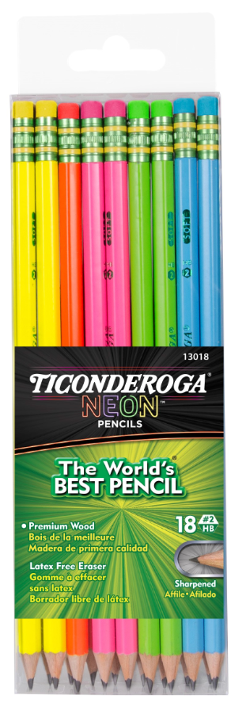
Ticonderoga® 18ct Neon
#2 Wood Case Pencil
Five bright, neon colors
Neon, latex-free eraser matches barrel color and provides easy, clean corrections
Pre-sharpened to save you time
Exclusive #2 graphite formula provides extra smooth performance
PMA certified non-toxic
Product SKU # | Office City of Miami
X13018 | (786)-473-1828

Slide 12
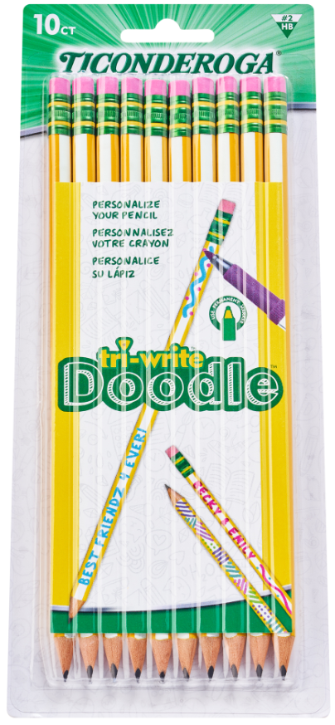
Ticonderoga® 10ct tri-write Doodle
#2 Wood Case Pencil
Personalize your pencil!
Triangle shape promotes proper grip
One side has white stripe for personalizing
Use permanent marker for customizing
Exclusive #2 graphite formula provides extra smooth performance
Top quality, latex-free eraser provides easy, clean corrections
PMA certified non-toxic
Product SKU # | Office City of Miami
X13110 | (786)-473-1828

Slide 13
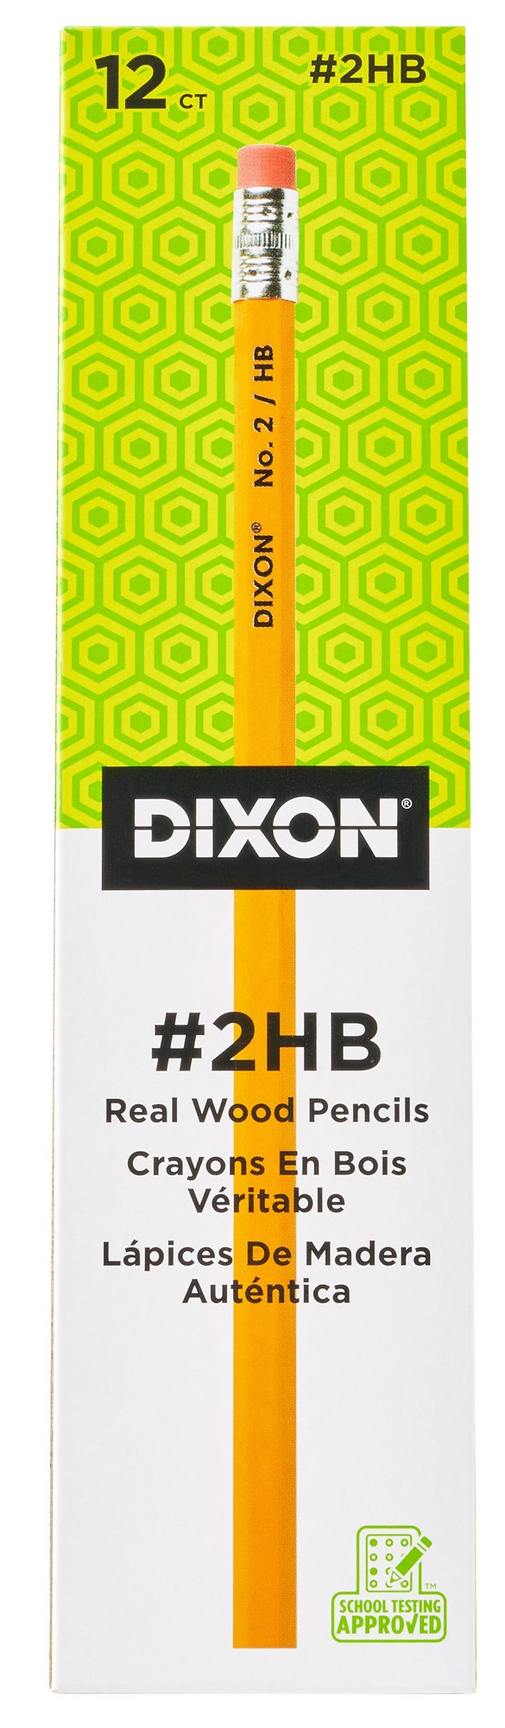
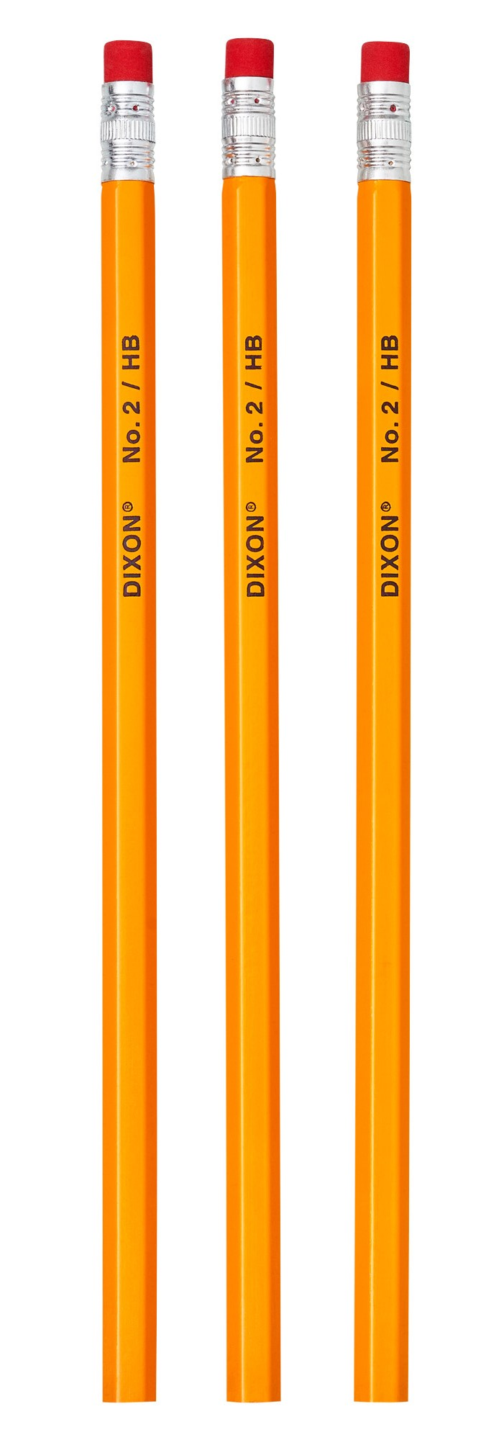
Dixon® #2 Yellow Economy Pencils, 12 ct.
Highest quality, economically priced pencils
Cased in 100% real non-rainforest wood
Quality graphite core for smooth writing
Latex-free erasers for easy, clean corrections
PMA Certified non-toxic
12 pencils per box
Product SKU # | Office City of Miami
X14402X | (786)-473-1828
New Packaging Coming Soon

Slide 14
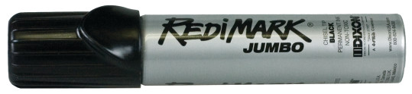
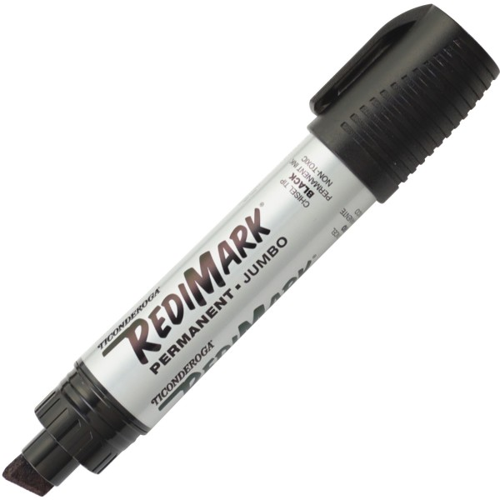
Ticonderoga® 1ct RediMark® Jumbo Permanent Marker
Marks on almost anything
Oversized chisel tip
Provides bold marks for easy and quick identification
Fast drying, permanent black ink
1ct blister card
6 blister cards per box
AP Certified Non-toxic
Product SKU # | Office City of Miami
X87021 | (786)-473-1828

